Slide 1
Principal Component Analysis (Math)

Slide 2
Outline
Projecting Data
PCA Concepts
Mean
Variance
Covariance
Covariance Matrix
Linear Transformation
Eigenvalues and Eigenvectors
How PCA Works?

Slide 3
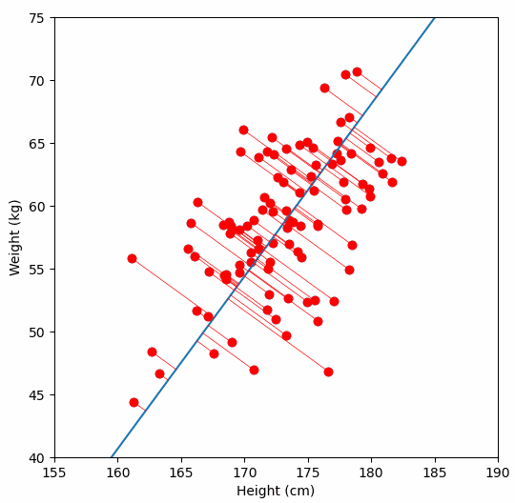
Projecting Data
Projecting data in PCA is the process of transforming high-dimensional data onto a lower-dimensional space (a "subspace") using new axes called principal components (PCs),

Slide 4
Projecting Data
Principal components (PCs) are directions of maximum data variance, effectively creating a "shadow" where data points are represented by their scores (coordinates) along these new axes, reducing complexity while keeping essential information for tasks like visualization or modeling.

Slide 5

400
300
Size
200
100
1
2
3
4
5
Number of Rooms

Slide 6
400
300
Size
200
100
1
2
3
4
5
Number of Rooms

Slide 7
400
300
Size
200
100
1
2
3
4
5
Number of Rooms

Slide 8
400
300
Size
200
100
1
2
3
4
5
Number of Rooms

Slide 10
1 dimension

Slide 11
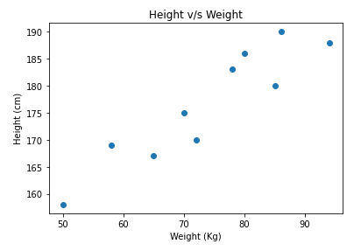
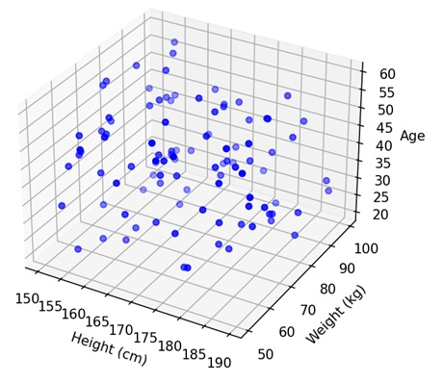
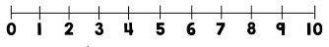
Dimensions
One feature
(Height)
Two features
(Height and Weight)
Three features
(Height, Weight and Age)
For datasets with more than three features, we simply cannot draw it.

Slide 12
Outline
Projecting Data
PCA Concepts
Mean
Variance
Covariance
Covariance Matrix
Linear Transformation
Eigenvalues and Eigenvectors
How PCA Works?

Slide 13
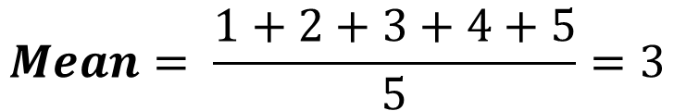
Mean
House A
House B
House C
House D
House E
1
2
3
4
5
$$Mean= \frac{1+2+3+4+5}{5}=3$$
House C is the mean

Slide 14
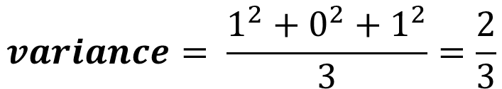
Variance in One Dimension
House B and House D is 1 point away from the mean
House B
1
House C
1
House D
$$variance= \frac{1^{2}+0^{2}+1^{2}}{3}=\frac{2}{3}$$

Slide 15
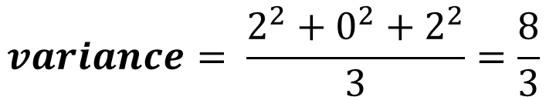
Variance in One Dimension
House A and House E is 2 points away from the mean
House B
1
House C
1
House D
$$variance= \frac{1^{2}+0^{2}+1^{2}}{3}=\frac{2}{3}$$
House E
House A
2
House C
2
$$variance= \frac{2^{2}+0^{2}+2^{2}}{3}=\frac{8}{3}$$

Slide 16
How about the variance for two-dimensional data? Can we use the same method?

Slide 17
For two-dimensional data, we need to get the variance of the x-axis (x-variance)….

Slide 18
And the of the y-axis (y-variance)

Slide 19
And the of the y-axis (y-variance)

Slide 20
But there will be datasets that are different but will have the same x-variance and y-variance.

Slide 21
2
2
2
2
1
1
1
1
Look at these two datasets. If you notice they are different from each other, but they will have the same x-variance and y-variance.

Slide 22
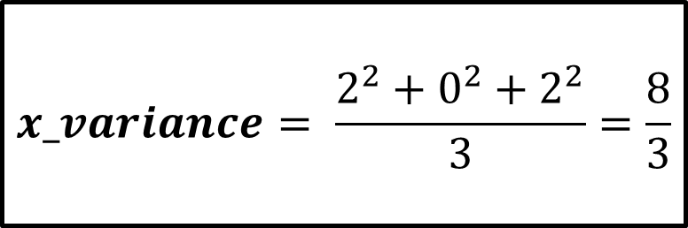
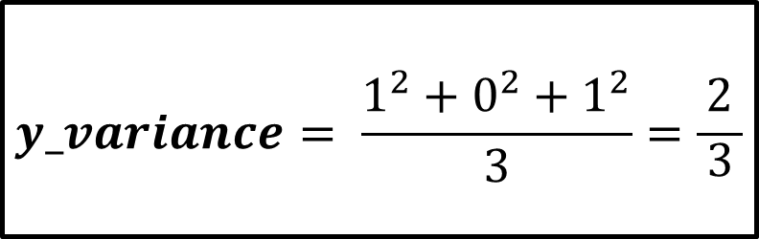
2
2
2
2
1
1
1
1
$$x_variance= \frac{2^{2}+0^{2}+2^{2}}{3}=\frac{8}{3}$$
$$y_variance= \frac{1^{2}+0^{2}+1^{2}}{3}=\frac{2}{\begin{aligned}3 \\ \end{aligned}}$$

Slide 23
2
2
2
2
1
1
1
1
Is there another metric to tell us that these two are different?
Yes! Its called covariance

Slide 24

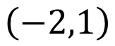
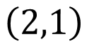
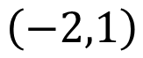

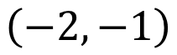

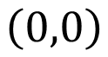

Sum of Product of Coordinates
$$\left(−2,1\right)$$
$$\left(2,1\right)$$
$$−2$$
$$+2$$
$$\left(0,0\right)$$
$$\left(−2,−1\right)$$
$$\left(−2,1\right)$$
$$+2$$
$$−2$$

Slide 25
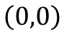
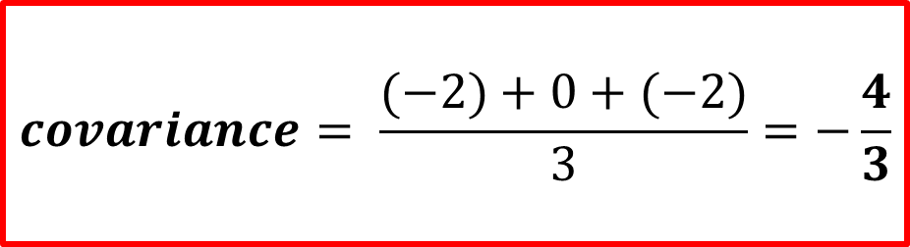
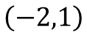




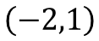
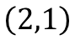
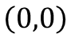
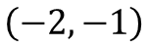
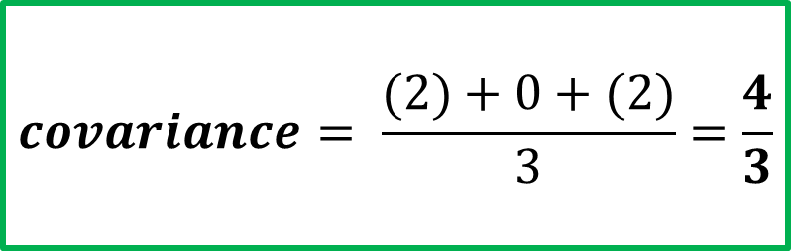
$$\left(−2,1\right)$$
$$\left(2,1\right)$$
$$−2$$
$$+2$$
$$\left(0,0\right)$$
$$\left(0,0\right)$$
$$\left(−2,1\right)$$
$$\left(−2,−1\right)$$
$$−2$$
$$+2$$
$$covariance= \frac{(−2)+0+(−2)}{3}=−\frac{4}{3}$$
$$covariance= \frac{(2)+0+(2)}{3}=\frac{4}{3}$$

Slide 26
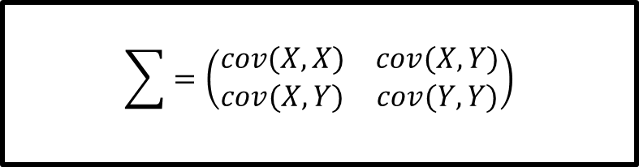
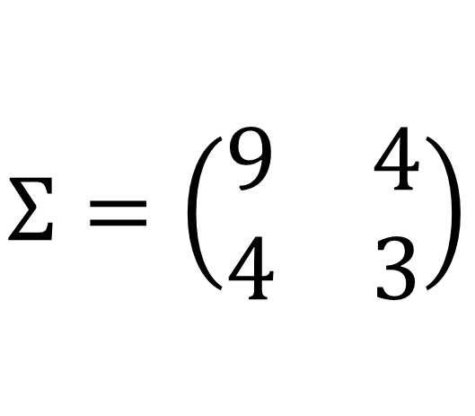
$$\sum{=\left(\begin{matrix}cov(X,X) & cov(X,Y) \\ cov(X,Y) & cov(Y,Y)\end{matrix}\right)}$$
$$Σ=\left(\begin{matrix}9 & 4 \\ 4 & 3\end{matrix}\right)$$

Slide 27
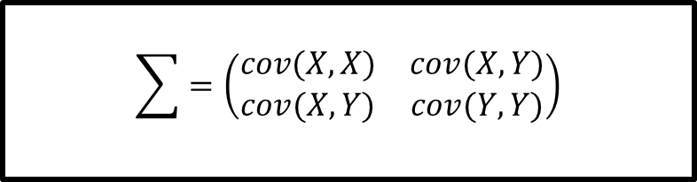
Covariance Matrix
The covariance matrix is a square matrix with diagonal elements that represent the variance and the non-diagonal components that express covariance.
$$\sum{=\left(\begin{matrix}cov(X,X) & cov(X,Y) \\ cov(X,Y) & cov(Y,Y)\end{matrix}\right)}$$

Slide 28
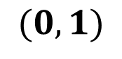
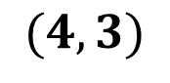
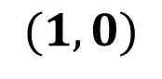
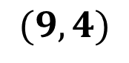
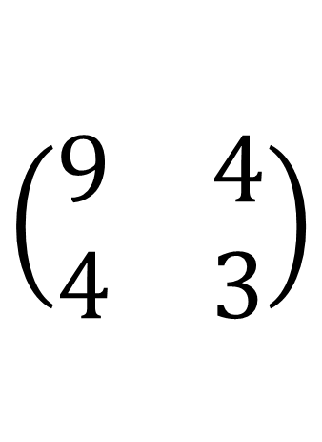
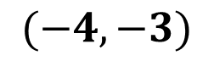
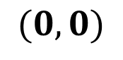
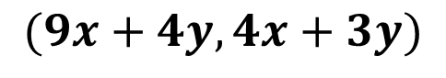
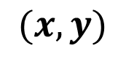
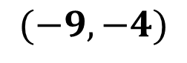
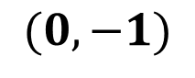
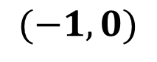
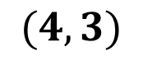
$$\left(\begin{matrix}9 & 4 \\ 4 & 3\end{matrix}\right)$$
$$(x,y)$$
If we apply the covariance matrix to our graph from the left, this will result in a graph in the right.
$$(9x+4y, 4x+3y)$$
$$(0,0)$$
$$(9,4)$$
$$(1,0)$$
$$(4,3)$$
$$(0,1)$$
$$(4,3)$$
$$(−1,0)$$
$$(−9,−4)$$
$$(0,−1)$$
$$(−4,−3)$$

Slide 29
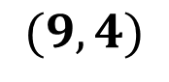
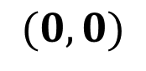
$$\left(\begin{matrix}9 & 4 \\ 4 & 3\end{matrix}\right)$$
$$(x,y)$$
We can see that the original graph was extended in two directions
$$(9x+4y, 4x+3y)$$
$$(0,0)$$
$$(0,0)$$
$$(1,0)$$
$$(9,4)$$
$$(0,1)$$
$$(4,3)$$
$$(−1,0)$$
$$(−9,−4)$$
$$(0,−1)$$
$$(−4,−3)$$

Slide 30
$$\left(\begin{matrix}9 & 4 \\ 4 & 3\end{matrix}\right)$$
$$(x,y)$$
This is called linear tranformation
$$(9x+4y, 4x+3y)$$
$$(0,0)$$
$$(0,0)$$
$$(1,0)$$
$$(9,4)$$
$$(0,1)$$
$$(4,3)$$
$$(−1,0)$$
$$(−9,−4)$$
$$(0,−1)$$
$$(−4,−3)$$

Slide 31
$$\left(\begin{matrix}9 & 4 \\ 4 & 3\end{matrix}\right)$$
Eigenvector (direction)
Eigenvalues (magnitude)
When we apply linear transformation, we need to know in which direction and how long (magnitude) it gets stretched or compressed.

Slide 32

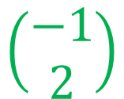


$$\left(\begin{matrix}9 & 4 \\ 4 & 3\end{matrix}\right)$$
$$\left(\begin{aligned}−1 \\ 2\end{aligned}\right)$$
$$\left(\begin{aligned}2 \\ 1\end{aligned}\right)$$
$$1$$
$$11$$
Eigenvector (direction)
Eigenvalues (magnitude)
When we apply linear transformation, we need to know in which direction and how long (magnitude) it gets stretched or compressed.

Slide 33

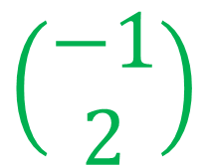
Eigenvector
(direction)
$$\left(\begin{aligned}2 \\ 1\end{aligned}\right)$$
$$\left(\begin{aligned}−1 \\ 2\end{aligned}\right)$$

Slide 34


Eigenvector
(direction)
$$\left(\begin{aligned}2 \\ 1\end{aligned}\right)$$
$$\left(\begin{aligned}−1 \\ 2\end{aligned}\right)$$
Eigenvalues(magnitude)
$$11$$
$$1$$

Slide 35
Outline
Projecting Data
PCA Concepts
Mean
Variance
Covariance
Covariance Matrix
Linear Transformation
Eigenvalues and Eigenvectors
How PCA Works?

Slide 36
For example, we have this dataset

Slide 37
Step 1: Find the center of mass or the mean of the data

Slide 38
Step 1: Find the center of mass or the mean of the data

Slide 39
Step 1: Find the center of mass or the mean of the data

Slide 40
Step 3: Find the covariance matrix

Slide 41
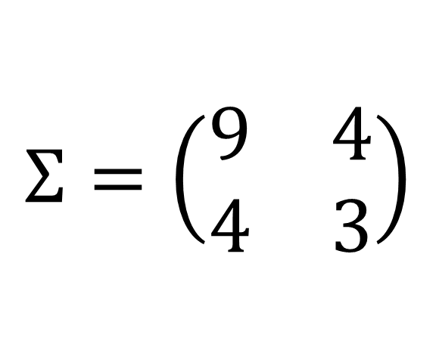
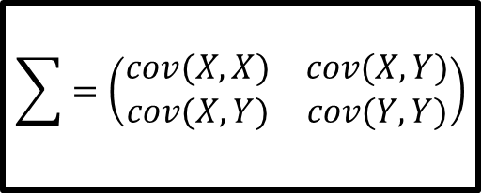
$$\sum{=\left(\begin{matrix}cov(X,X) & cov(X,Y) \\ cov(X,Y) & cov(Y,Y)\end{matrix}\right)}$$
$$Σ=\left(\begin{matrix}9 & 4 \\ 4 & 3\end{matrix}\right)$$
Step 3: Find the covariance matrix

Slide 42

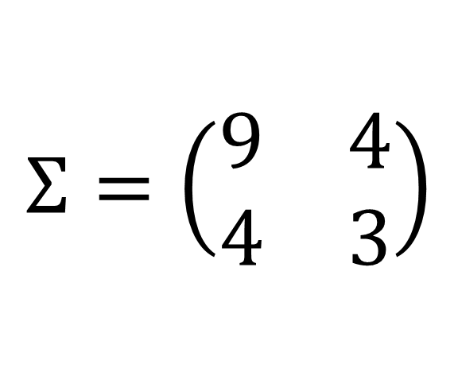
$$Av= λv$$
$$Σ=\left(\begin{matrix}9 & 4 \\ 4 & 3\end{matrix}\right)$$
Step 4: Create principal components by finding the eigenvectors and eigenvalues

Slide 43
For example, we have this dataset

Slide 44
Step 1: Find the center of mass or the mean of the data

Slide 45
Step 1: Find the center of mass or the mean of the data

Slide 46
Step 2: Put the center of mass/mean at the origin

Slide 47
Step 2: Put the center of mass/mean at the origin

Slide 48
Step 3: Find the covariance matrix

Slide 49
$$\sum{=\left(\begin{matrix}cov(X,X) & cov(X,Y) \\ cov(X,Y) & cov(Y,Y)\end{matrix}\right)}$$
$$Σ=\left(\begin{matrix}9 & 4 \\ 4 & 3\end{matrix}\right)$$
Step 3: Find the covariance matrix

Slide 50
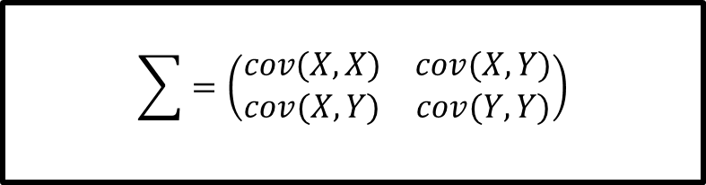
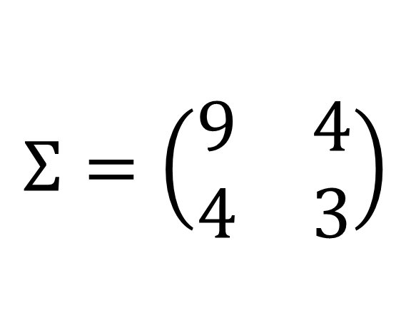
$$\sum{=\left(\begin{matrix}cov(X,X) & cov(X,Y) \\ cov(X,Y) & cov(Y,Y)\end{matrix}\right)}$$
$$Σ=\left(\begin{matrix}9 & 4 \\ 4 & 3\end{matrix}\right)$$

Slide 51
$$Av= λv$$
$$Σ=\left(\begin{matrix}9 & 4 \\ 4 & 3\end{matrix}\right)$$
Step 4: Create principal components by finding the eigenvectors and eigenvalues

Slide 52


$$Av= λv$$
Where:
$A$ is a covariance matrix
$v$ is the eigenvector
$λ$ is the eigenvalue

Slide 53








$$Av= λv$$
$$A v−λv=0$$
$$\left(A −λ\right)v=0$$
$$(A−λI)v=0$$
$I$ is an identity matrix $\left[\begin{matrix}1 & 0 \\ 0 & 1\end{matrix}\right]$
$$det\left(A −λI\right)=0$$

Slide 54





$$A v= λv$$
$$A v−λv=0$$
$$\left(A −λ\right)v=0$$
$$(A−λI)v=0$$
$$det\left(A −λI\right)=0$$

Slide 55






Compute the Determinant
$$det\left(A −λI\right)=0$$
Plug in the identity matrix $I$ and covariance matrix $A$
$$\left|\left[\begin{matrix}9 & 4 \\ 4 & 3\end{matrix}\right]−λ\left[\begin{matrix}1 & 0 \\ 0 & 1\end{matrix}\right]\right|=0$$
Perform scalar matrix multiplication
$$\left|\left[\begin{matrix}9 & 4 \\ 4 & 3\end{matrix}\right]−\left[\begin{matrix}λ & 0 \\ 0 & λ\end{matrix}\right]\right|=0$$
Subtract matrices
$$\left|\begin{matrix}9−λ & 4 \\ 4 & 3−λ\end{matrix}\right|=0$$
Find the determinant of the matrix
$$\left(9−λ\right)−\left(3−λ\right)−16=0$$

Slide 56






Solve for the eigenvalues
$$\left(9−λ\right)−\left(3−λ\right)−16=0$$
Simplify
$$27−9λ−3λ+λ^{2}−16=0$$
$$λ^{2}−12λ+11=0$$
$$(λ−11)(λ−1)=0$$
$$λ_{1}=11$$
$$λ_{2}=1$$

Slide 57










Find the eigenvectors
$$A=\left[\begin{matrix}9 & 4 \\ 4 & 3\end{matrix}\right]$$
$$v=\left[\begin{aligned}v_{1} \\ v_{2}\end{aligned}\right]$$
$$(A−λI)v=0$$
Plug in the identity matrix $I$ and covariance matrix $A$
$$λ_{1}=11$$
$$\left(\left[\begin{matrix}9 & 4 \\ 4 & 3\end{matrix}\right]−λ\left[\begin{matrix}1 & 0 \\ 0 & 1\end{matrix}\right]\right)\left[\begin{aligned}v_{1} \\ v_{2}\end{aligned}\right]=0$$
Perform scalar matrix multiplication
$$\left(\left[\begin{matrix}9 & 4 \\ 4 & 3\end{matrix}\right]−\left[\begin{matrix}λ & 0 \\ 0 & λ\end{matrix}\right]\right)\left[\begin{aligned}v_{1} \\ v_{2}\end{aligned}\right]=0$$
Replace lambda with the first eigenvalue
$$\left(\left[\begin{matrix}9 & 4 \\ 4 & 3\end{matrix}\right]−\left[\begin{matrix}11 & 0 \\ 0 & 11\end{matrix}\right]\right)\left[\begin{aligned}v_{1} \\ v_{2}\end{aligned}\right]=0$$
Subtract matrices
$$\left[\begin{matrix}−2 & 4 \\ 4 & −8\end{matrix}\right]\left[\begin{aligned}v_{1} \\ v_{2}\end{aligned}\right]=0$$

Slide 58





Find the eigenvectors
$$A=\left[\begin{matrix}9 & 4 \\ 4 & 3\end{matrix}\right]$$
$$v=\left[\begin{aligned}v_{1} \\ v_{2}\end{aligned}\right]$$
$$\left[\begin{matrix}−2 & 4 \\ 4 & −8\end{matrix}\right]\left[\begin{aligned}v_{1} \\ v_{2}\end{aligned}\right]=0$$
Multiply the two matrices
$$λ_{1}=11$$
$$\left[\begin{aligned}−2v_{1}+4v_{2}=0 \\ 4v_{1}−8v_{2}=0\end{aligned}\right]$$
$$\left[\begin{aligned}4v_{2}=2v_{1} \\ 4v_{1}=8v_{2} \end{aligned}\right]$$
$$\left[\begin{aligned}{2v}_{2}=v_{1} \\ v_{1}={2v}_{2} \end{aligned}\right]$$
$$v=\left[\begin{aligned}2 \\ 1\end{aligned}\right]$$

Slide 59

















$$\left(A −λI\right)v=0$$
$$A=\left[\begin{matrix}9 & 4 \\ 4 & 3\end{matrix}\right]$$
$$v=\left[\begin{aligned}v_{1} \\ v_{2}\end{aligned}\right]$$
$$\left(\left[\begin{matrix}9 & 4 \\ 4 & 3\end{matrix}\right]−λ\left[\begin{matrix}1 & 0 \\ 0 & 1\end{matrix}\right]\right)\left[\begin{aligned}v_{1} \\ v_{2}\end{aligned}\right]=0$$
$$λ_{1}=11$$
$$\left(\left[\begin{matrix}9 & 4 \\ 4 & 3\end{matrix}\right]−\left[\begin{matrix}λ & 0 \\ 0 & λ\end{matrix}\right]\right)\left[\begin{aligned}v_{1} \\ v_{2}\end{aligned}\right]=0$$
$$λ_{2}=1$$
$$\left(\left[\begin{matrix}9 & 4 \\ 4 & 3\end{matrix}\right]−\left[\begin{matrix}11 & 0 \\ 0 & 11\end{matrix}\right]\right)\left[\begin{aligned}v_{1} \\ v_{2}\end{aligned}\right]=0$$
$$\left(\left[\begin{matrix}−2 & 4 \\ 4 & −8\end{matrix}\right]\right)\left[\begin{aligned}v_{1} \\ v_{2}\end{aligned}\right]=0$$
$$−2v_{1}+4v_{2}=0$$
$$4v_{2}=2v_{1}$$
$$2v_{2}=v_{1}$$
$$v_{1}=2$$
$$v_{2}=1$$
$$v=\left[\begin{aligned}2 \\ 1\end{aligned}\right]$$
$$4v_{1}−8v_{2}=0$$
$$4v_{1}=8v_{2}$$
$$x_{1}=2v_{2}$$

Slide 60



Find the eigenvectors
$$A=\left[\begin{matrix}9 & 4 \\ 4 & 3\end{matrix}\right]$$
$$v=\left[\begin{aligned}v_{1} \\ v_{2}\end{aligned}\right]$$
$$(A−λI)v=0$$
Plug in the identity matrix $I$ and covariance matrix $A$
$$λ_{2}=1$$
$$\left(\left[\begin{matrix}9 & 4 \\ 4 & 3\end{matrix}\right]−λ\left[\begin{matrix}1 & 0 \\ 0 & 1\end{matrix}\right]\right)\left[\begin{aligned}v_{1} \\ v_{2}\end{aligned}\right]=0$$
Perform scalar matrix multiplication
$$\left(\left[\begin{matrix}9 & 4 \\ 4 & 3\end{matrix}\right]−\left[\begin{matrix}λ & 0 \\ 0 & λ\end{matrix}\right]\right)\left[\begin{aligned}v_{1} \\ v_{2}\end{aligned}\right]=0$$
Replace lambda with the first eigenvalue
$$\left(\left[\begin{matrix}9 & 4 \\ 4 & 3\end{matrix}\right]−\left[\begin{matrix}1 & 0 \\ 0 & 1\end{matrix}\right]\right)\left[\begin{aligned}v_{1} \\ v_{2}\end{aligned}\right]=0$$
Subtract matrices
$$\left[\begin{matrix}8 & 4 \\ 4 & 2\end{matrix}\right]\left[\begin{aligned}v_{1} \\ v_{2}\end{aligned}\right]=0$$

Slide 61





Find the eigenvectors
$$A=\left[\begin{matrix}9 & 4 \\ 4 & 3\end{matrix}\right]$$
$$v=\left[\begin{aligned}v_{1} \\ v_{2}\end{aligned}\right]$$
$$\left[\begin{matrix}8 & 4 \\ 4 & 2\end{matrix}\right]\left[\begin{aligned}v_{1} \\ v_{2}\end{aligned}\right]=0$$
Multiply the two matrices
$$λ_{2}=1$$
$$\left[\begin{aligned}8v_{1}+4v_{2}=0 \\ 4v_{1}+2v_{2}=0\end{aligned}\right]$$
$$\left[\begin{aligned}8v_{1}=−4v_{2} \\ 4v_{1}=−2v_{2} \end{aligned}\right]$$
$$\left[\begin{aligned}{2v}_{1}={−v}_{2} \\ {2v}_{1}={−v}_{2} \end{aligned}\right]$$
$$v=\left[\begin{aligned}−1 \\ 2\end{aligned}\right]$$

Slide 62









Check if correct
$$A v= λv$$
$$A=\left[\begin{matrix}9 & 4 \\ 4 & 3\end{matrix}\right]$$
$$\left[\begin{matrix}9 & 4 \\ 4 & 3\end{matrix}\right] v=λv$$
$$\left[\begin{matrix}9 & 4 \\ 4 & 3\end{matrix}\right] v=11v$$
$$λ_{1}=11$$
$$\left[\begin{matrix}9 & 4 \\ 4 & 3\end{matrix}\right]\left[\begin{aligned}2 \\ 1\end{aligned}\right]=11\left[\begin{aligned}2 \\ 1\end{aligned}\right]$$
$$v=\left[\begin{aligned}2 \\ 1\end{aligned}\right]$$
$$\left[\begin{aligned}18+4 \\ 8+3\end{aligned}\right]=\left[\begin{aligned}22 \\ 11\end{aligned}\right]$$
$$\left[\begin{aligned}22 \\ 11\end{aligned}\right] =\left[\begin{aligned}22 \\ 11\end{aligned}\right]$$

Slide 63






Check if correct
$$A v= λv$$
$$A=\left[\begin{matrix}9 & 4 \\ 4 & 3\end{matrix}\right]$$
$$\left[\begin{matrix}9 & 4 \\ 4 & 3\end{matrix}\right] v=λv$$
$$\left[\begin{matrix}9 & 4 \\ 4 & 3\end{matrix}\right] v=1v$$
$$λ_{2}=1$$
$$\left[\begin{matrix}9 & 4 \\ 4 & 3\end{matrix}\right]\left[\begin{aligned}−1 \\ 2\end{aligned}\right]=1\left[\begin{aligned}−1 \\ 2\end{aligned}\right]$$
$$v=\left[\begin{aligned}−1 \\ 2\end{aligned}\right]$$
$$\left[\begin{aligned}−9+8 \\ −4+6\end{aligned}\right]=\left[\begin{aligned}−1 \\ 2\end{aligned}\right]$$
$$\left[\begin{aligned}−1 \\ 2\end{aligned}\right] =\left[\begin{aligned}−1 \\ 2\end{aligned}\right]$$

Slide 64













$$\left(A −λI\right)v=0$$
$$A=\left[\begin{matrix}9 & 4 \\ 4 & 3\end{matrix}\right]$$
$$v=\left[\begin{aligned}v_{1} \\ v_{2}\end{aligned}\right]$$
$$\left(\left[\begin{matrix}9 & 4 \\ 4 & 3\end{matrix}\right]−λ\left[\begin{matrix}1 & 0 \\ 0 & 1\end{matrix}\right]\right)\left[\begin{aligned}v_{1} \\ v_{2}\end{aligned}\right]=0$$
$$λ_{1}=11$$
$$\left(\left[\begin{matrix}9 & 4 \\ 4 & 3\end{matrix}\right]−\left[\begin{matrix}λ & 0 \\ 0 & λ\end{matrix}\right]\right)\left[\begin{aligned}v_{1} \\ v_{2}\end{aligned}\right]=0$$
$$λ_{2}=1$$
$$\left(\left[\begin{matrix}9 & 4 \\ 4 & 3\end{matrix}\right]−\left[\begin{matrix}1 & 0 \\ 0 & 1\end{matrix}\right]\right)\left[\begin{aligned}v_{1} \\ v_{2}\end{aligned}\right]=0$$
$$\left(\left[\begin{matrix}8 & 4 \\ 4 & 2\end{matrix}\right]\right)\left[\begin{aligned}v_{1} \\ v_{2}\end{aligned}\right]=0$$
$$8v_{1}+4v_{2}=0$$
$$8v_{1}=−4v_{2}$$
$${2v}_{1}={−v}_{2}$$
$$v_{1}=−1$$
$$v_{2}=2$$
$$v=\left[\begin{aligned}−1 \\ 2\end{aligned}\right]$$
$$4v_{1}+2v_{2}=0$$
$$4v_{1}=−2v_{2}$$
$${2v}_{1}=−v_{2}$$

Slide 65









$$A v= λv$$
$$A=\left[\begin{matrix}9 & 4 \\ 4 & 3\end{matrix}\right]$$
$$λ_{1}=11$$
$$\left[\begin{matrix}9 & 4 \\ 4 & 3\end{matrix}\right] v=λv$$
$$v=\left[\begin{aligned}2 \\ 1\end{aligned}\right]$$
$$\left[\begin{matrix}9 & 4 \\ 4 & 3\end{matrix}\right] v=11v$$
$$\left[\begin{matrix}9 & 4 \\ 4 & 3\end{matrix}\right]\left[\begin{aligned}2 \\ 1\end{aligned}\right]=11\left[\begin{aligned}2 \\ 1\end{aligned}\right]$$
$$\left[\begin{aligned}18+4 \\ 8+3\end{aligned}\right]=\left[\begin{aligned}22 \\ 11\end{aligned}\right]$$
$$\left[\begin{aligned}22 \\ 11\end{aligned}\right] =\left[\begin{aligned}22 \\ 11\end{aligned}\right]$$

Slide 66









$$A=\left[\begin{matrix}9 & 4 \\ 4 & 3\end{matrix}\right]$$
$$A v= λv$$
$$λ_{2}=1$$
$$\left[\begin{matrix}9 & 4 \\ 4 & 3\end{matrix}\right] v=λv$$
$$v=\left[\begin{aligned}−1 \\ 2\end{aligned}\right]$$
$$\left[\begin{matrix}9 & 4 \\ 4 & 3\end{matrix}\right] v=1v$$
$$\left[\begin{matrix}9 & 4 \\ 4 & 3\end{matrix}\right]\left[\begin{aligned}−1 \\ 2\end{aligned}\right]=1\left[\begin{aligned}−1 \\ 2\end{aligned}\right]$$
$$\left[\begin{aligned}−9+8 \\ 8−6\end{aligned}\right]=\left[\begin{aligned}−1 \\ 2\end{aligned}\right]$$
$$\left[\begin{aligned}−1 \\ 2\end{aligned}\right] =\left[\begin{aligned}−1 \\ 2\end{aligned}\right]$$

Slide 67
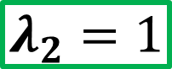
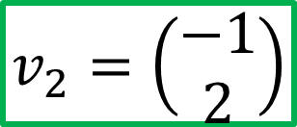
$$λ_{2}=1$$
$$v_{2}=\left(\begin{aligned}−1 \\ 2\end{aligned}\right)$$
If we draw the eigenvectors and eigenvalues in our two- dimensional graph. It will look like this

Slide 68
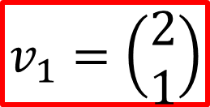

$$λ_{2}=1$$
$$λ_{1}=11$$
$$v_{2}=\left(\begin{aligned}−1 \\ 2\end{aligned}\right)$$
$$v_{1}=\left(\begin{aligned}2 \\ 1\end{aligned}\right)$$
If we draw the eigenvectors and eigenvalues in our two- dimensional graph. It will look like this

Slide 69
$$λ_{2}=1$$
$$λ_{1}=11$$
$$v_{2}=\left(\begin{aligned}−1 \\ 2\end{aligned}\right)$$
$$v_{1}=\left(\begin{aligned}2 \\ 1\end{aligned}\right)$$
Step 5: Choose a principal component. In our example, we have two principal components, PC1 and PC2

Slide 70


$$λ_{2}=1$$
$$λ_{1}=11$$
$$v_{2}=\left(\begin{aligned}−1 \\ 2\end{aligned}\right)$$
$$v_{1}=\left(\begin{aligned}2 \\ 1\end{aligned}\right)$$
In PCA, we can choose which principal component to project our data. Let us choose PC1

Slide 71
$$λ_{1}=11$$
$$v_{1}=\left(\begin{aligned}2 \\ 1\end{aligned}\right)$$
We then make PC1 symmetrical by extending it to the other direction

Slide 72
$$λ_{1}=11$$
$$v_{1}=\left(\begin{aligned}2 \\ 1\end{aligned}\right)$$
We then make PC1 symmetrical by extending it to the other direction

Slide 73
$$λ_{1}=11$$
$$v_{1}=\left(\begin{aligned}2 \\ 1\end{aligned}\right)$$
Step 5: Project our data to PC1 to make it one-dimensional

Slide 74
$$λ_{1}=11$$
$$v_{1}=\left(\begin{aligned}2 \\ 1\end{aligned}\right)$$
Step 5: Project our data to PC1 to make it one-dimensional

Slide 75
$$λ_{1}=11$$
$$v_{1}=\left(\begin{aligned}2 \\ 1\end{aligned}\right)$$
Step 5: Project our data to PC1 to make it one-dimensional

Slide 76
In summary…

Slide 77
Step 1: Find the center of the dataset and put the center in the origin

Slide 78

$$covariance=\left(\begin{matrix}9 & 4 \\ 4 & 3\end{matrix}\right)$$
Step 2: Calculate the covariance matrix

Slide 79




$$covariance=\left(\begin{matrix}9 & 4 \\ 4 & 3\end{matrix}\right)$$
$$\left(\begin{aligned}2 \\ 1\end{aligned}\right)$$
$$\left(\begin{aligned}−1 \\ 2\end{aligned}\right)$$
Eigenvector
(direction)
Step 3: Get the eigenvectors and eigenvalues
Eigenvalues(magnitude)
$$11$$
$$1$$

Slide 80
$$covariance=\left(\begin{matrix}9 & 4 \\ 4 & 3\end{matrix}\right)$$
$$\left(\begin{aligned}2 \\ 1\end{aligned}\right)$$
$$\left(\begin{aligned}−1 \\ 2\end{aligned}\right)$$
Eigenvector
(direction)
Step 4: Choose the most important eigenvector and eigenvalue
Eigenvalues(magnitude)
$$11$$
$$1$$

Slide 81
Step 5: Project the data into the eigenvector. We now have converted our data from two dimension to one dimension

Slide 82
Step 5: Project the data into the eigenvector. We now have converted our data from two dimension to one dimension

Slide 83
Step 5: Project the data into the eigenvector. We now have converted our data from two dimension to one dimension

